Slide 1
Facilities and Safety Committee
CAC Meeting 11-27-18

Slide 2
Pros and Cons
Each facility has its own set of opportunities and challenges. Items that can be utilized in the future or enhanced easily are offset by items that are detrimental to the use of the facility or too costly to address. From our experience with the building the group has provided their opinion of the pros and cons of each facility.
Priorities

Slide 3
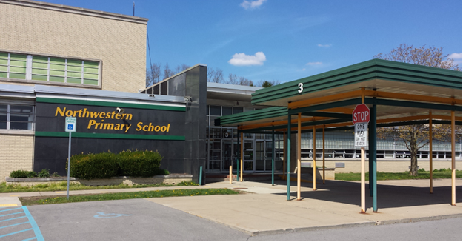
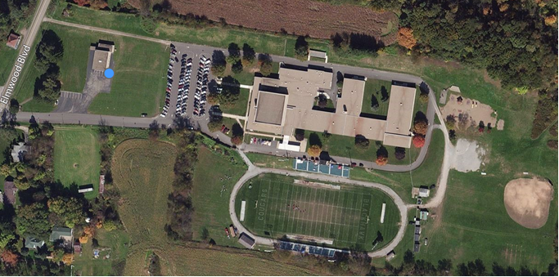
Northwestern
PROS AND CONS
PROS
Plenty of land
Local school to rural District residents
Newer roof
No elevator required
CONS
Total interior and exterior remodel needed
Water and sewage is not utility company provided
Questionable fast response by first responders
Not convenient to the majority of students
Water and sewage improvements may be a waste of money if these utilities are made available in the area and we are compelled to connect and abandon our systems.

Slide 4
Northwestern
PRIORITIES
Short Term
Maintain the District’s PA DEP water permit
Provide heat if we must
Mid Term
Install municipal water and sewers if plans to renovate this school move forward.
Long Term
Renovate Northwestern

Slide 5
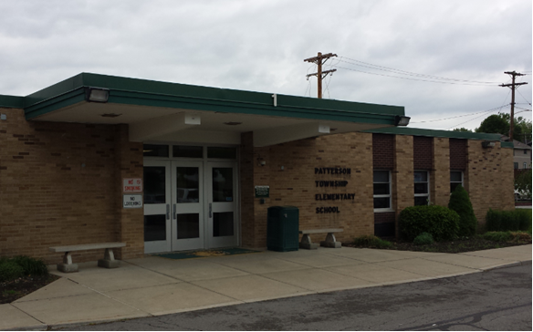
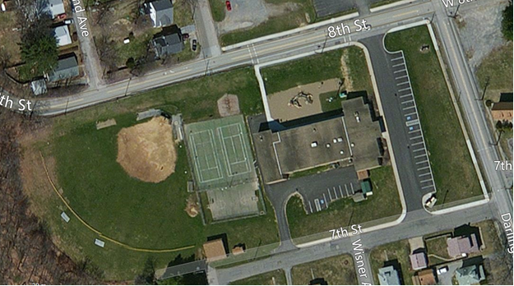
Patterson
PROS AND CONS
PROS
Neighborhood school
Captured entrance
New generator and transfer switch
CONS
Small building
Property is small no room for expansion, parking and play areas
Parking is currently insufficient
Needs a roof
HVAC system needs replaced entirely including UV’s and controls
Inefficient lighting
Gym is also the cafeteria
Elevator needed to provide access to both floors
Playground is not safe
Many ADA upgrades needed

Slide 6
PRIORITIES
Patterson
Short Term
Replace roofing
UV replacement
Replace windows
Clean, seal, caulk exterior masonry surfaces
Replace playground equipment
Improve building safety and code compliance
Mid Term
Remodel interior
Install an elevator
Improve ADA compliance
Improve parking so parking for events is sufficient
Long Term
If possible construct an addition that does not make previous improvements money wasted

Slide 7
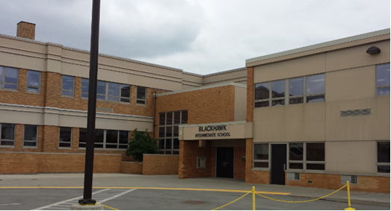
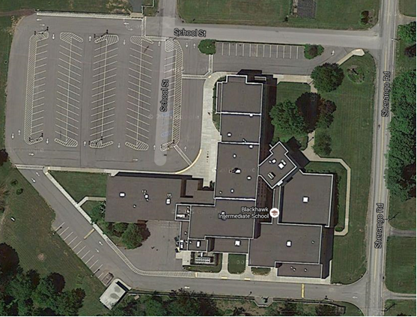
BIS
PROS AND CONS
PROS
Excellent location in the center of the district
Property is plentiful and flat
All utilities are present
Close to first responders
Newer roof
Currently functions as a school despite its many issues
Elevator in building
Remodeled library
CONS
Last renovation was in 1994, building dates to the 1930’s
Odd floor plan
Difficult to design out undesirable building issues
Does not allow easy use by persons with physical limitations
Total HVAC replacement needed
Building envelope leaks air and water
Windows need replaced and reduced in number
Leaking pipe insulation
Design issues for security
Inefficient lighting
Antiquated technology wiring
No real gymnasium
Lots of steps and confusing to navigate
Not code compliant railings in stairwells
Inefficient windows
No captured entrance
Old emergency generator and transfer switch

Slide 8
PRIORITIES
BIS
Short Term
Determine if the building has a future or if upgrades are not cost effective for a building with roots in the 1930’s
HVAC controls replacement
Replace unit ventilators (UV’s)
Paint stucco and continue to seal the building envelope
Upgrade lighting
Replace flooring
Mid Term
Replace entire HVAC system except controls
Eliminate and replace windows
Replace stucco/ EIFS
Clean, seal and caulk exterior brick surfaces
Continue to improve ADA compliance
Long Term
Upgrade bathrooms
Interior renovation

Slide 9
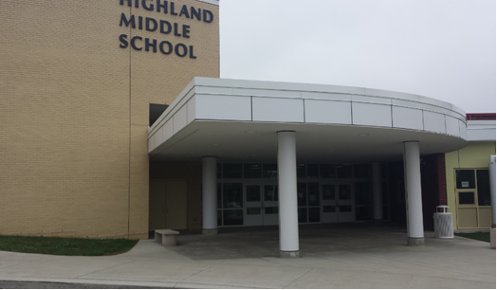
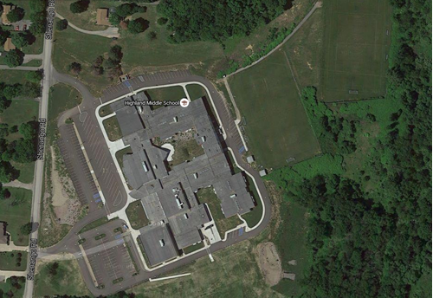
Highland Middle School
PROS AND CONS
PROS
Recently renovated
Plenty of land
Good access and location
CONS
Building requires preventative maintenance regularly
Electrical switch gear software needs updated
Roof is not of good quality but is warranted
This building requires a lot of preventative maintenance.
All HVAC equipment is TRANE equipment and most repairs require TRANE factory technicians

Slide 10
Highland Middle School
PRIORITIES
Short Term
Switch gear repair (software updates)
Vigilant maintenance
Changes to the condensate removal from the hallway AHU’s
Trane updates to LGI and cafeteria roof top units so that equipment goes into dehumidify and stays in dehumidify long enough to remove water from the air.
Mid Term
Vigilant maintenance
Clean, seal and caulk exterior masonry surfaces
Long Term
Continued maintenance
Replacement of systems as necessary

Slide 11
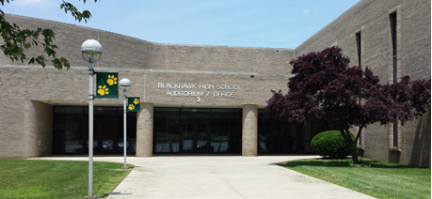
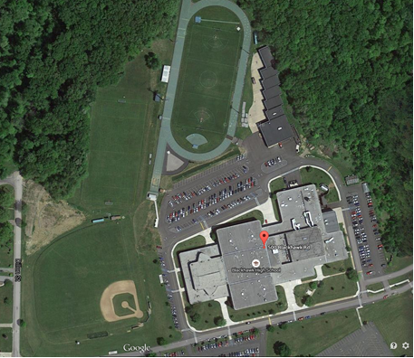
High School
PROS AND CONS
PROS
Large building in good physical condition
Large campus with plenty of parking for school
New roof
Physical Ed and sports equipment in good condition
New roof and exterior brick in very good condition
CONS
Built in 1972 and only HVAC system has been updated
Boiler piping needs replaced in crawl space
Drain piping needs replaced in some areas
Inefficient lighting
Inefficient windows
Large amount of exterior glass
Elevator needs replaced
Kitchen Walk-In freezer and cooler need replaced
Flooring needs replaced
Interior needs modernized
Commons (Pool Entrance) needs new doors
Generator and emergency power is original needs upgraded
No Captured entrance to the school
Paving needs repaired
Exterior lighting is inefficient
Technology wiring is inadequate
Clocks, bells, public address system needs replaced

Slide 12
High School
PRIORITIES
Short Term
Commons doors
Lighting upgrades piping replacement plan
Captured entrance
Walk –in cooler and freezer replacement
Paving repairs and paving maintenance plan district wide
PA, bells, clock system replacement
Elevator replacement
Flooring replacement
Auditorium renovation including lighting and stage improvements
Study and improve electrical energy efficiency
Improve stairwell rail safety
Replace track surface

Slide 13
High School
PRIORITIES
Mid Term
Improve energy efficiency
Continue piping replacement plan
Replace Interior doors and hardware
Replace gate valves throughout building
Clean, seal and caulk exterior masonry surfaces
Replace drain and boiler piping as needed
Interior renovation
Improve ADA compliance
Bathroom renovations
Interior renovation
Long Term
Continue interior renovation
Continue piping replacement plan
Bathroom replacement
Replace turf field

Slide 14
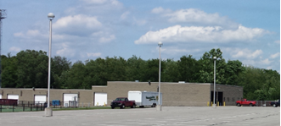
Maintenance Bldg.
PROS AND CONS
PROS
Location of building on campus makes it very versatile
New roof has been installed recently
All utilities are available in the building
CONS
Needs new man doors
No insulation
Heating is not energy efficient
No fire protection (sprinklers or alarm)
No safe way around building
Lighting is inefficient

Slide 15
Maintenance Bldg.
PRIORITIES
Short Term
Replace man doors
Improve energy efficiency of interior and exterior lighting and heating
Clean, seal and caulk masonry exterior
Improve building safety by insuring passage is safe around building.
Exit Signs
Mid Term
Replace garage doors
Insulate
Fire alarm system
Long Term
Ongoing maintenance and repairs

Slide 16
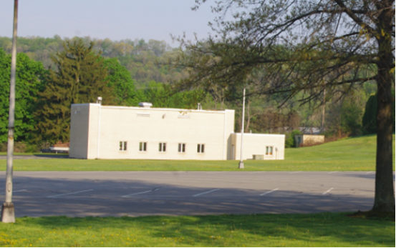
Annex Bldg.
PROS AND CONS
PROS
All utilities are present
Good roof
Good building structure
CONS
Dependent on northwestern
No obvious purpose.
May figure into a plan to make the property self -sufficient over the short term.

Slide 17
Annex Bldg.
PRIORITIES
Short Term
Replace windows and doors if used for storage.
Clean, seal and caulk masonry exterior
Mid Term
Install a fire alarm system
Long Term
Ongoing maintenance and repairs if building is still being used

Slide 18
SECURITY
Site access and circulation
Emergency responders
Building entrances/exits
Secure vestibules
Access control
Surveillance cameras
Interior and exterior glazing
Evacuation protocols
Staff training
Student drills

Slide 19
Next Steps
FURTHER DEFINE PRIORITIES AND IMMEDIATE NEEDS
DEVELOP PROBABLE COST ESTIMATES
DETERMINE SPATIAL UTILIZATION OF BUILDINGS
DETERMINE IF FACILITY IS WORTH MAINTAINING

Slide 20
Thank you
Facilities and Safety Committee

