Slide 1
Demographics Committee Review
November 27, 2018

Slide 2
Data
Mapping
Projections
Economic Changes
Notes:
Dan and Tom

Slide 3
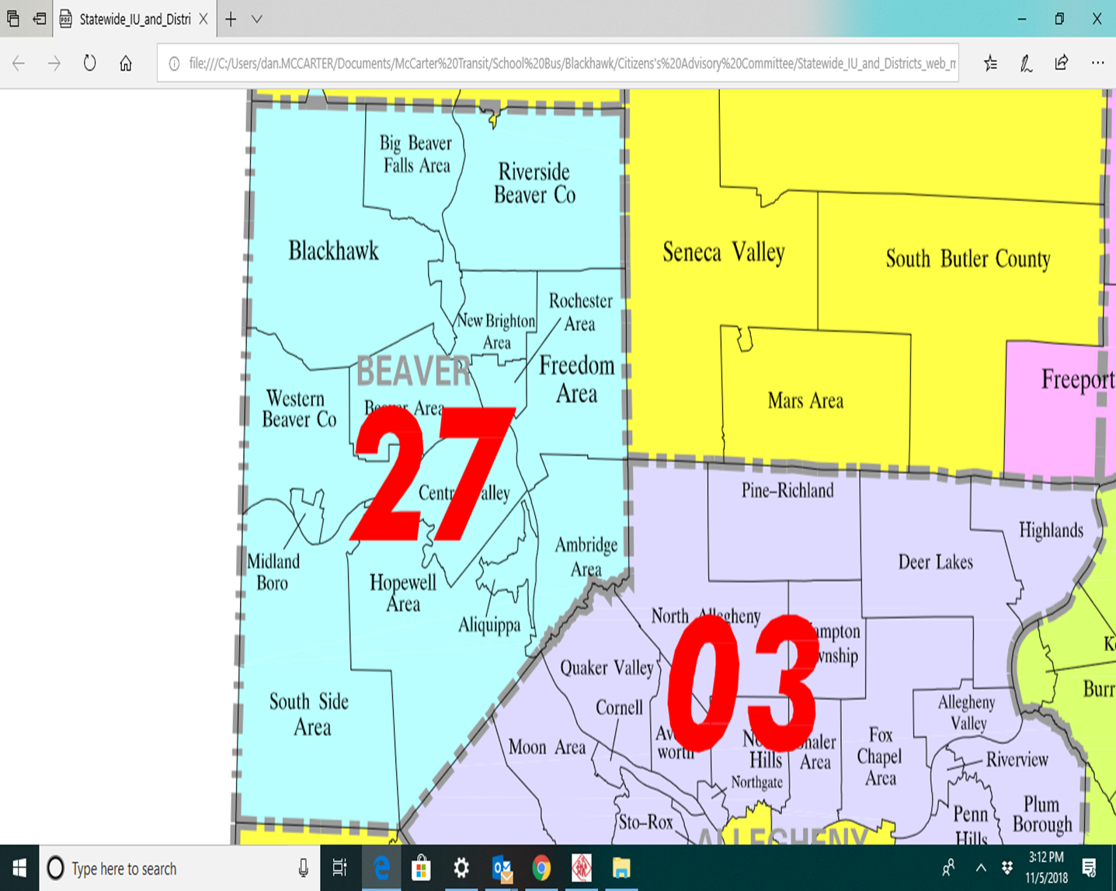
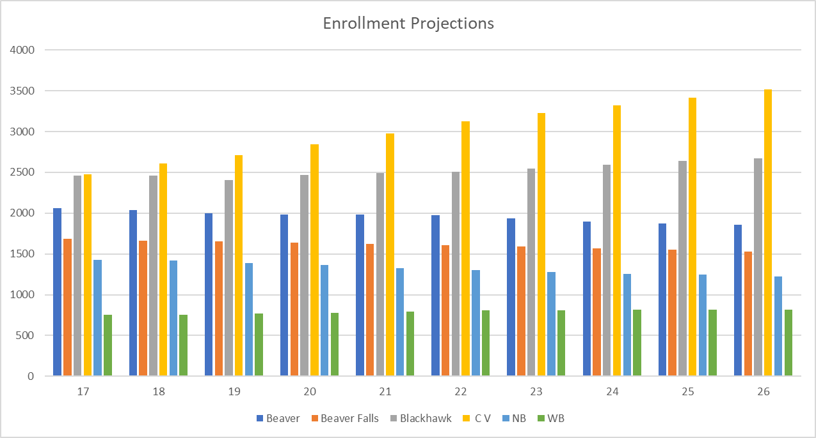
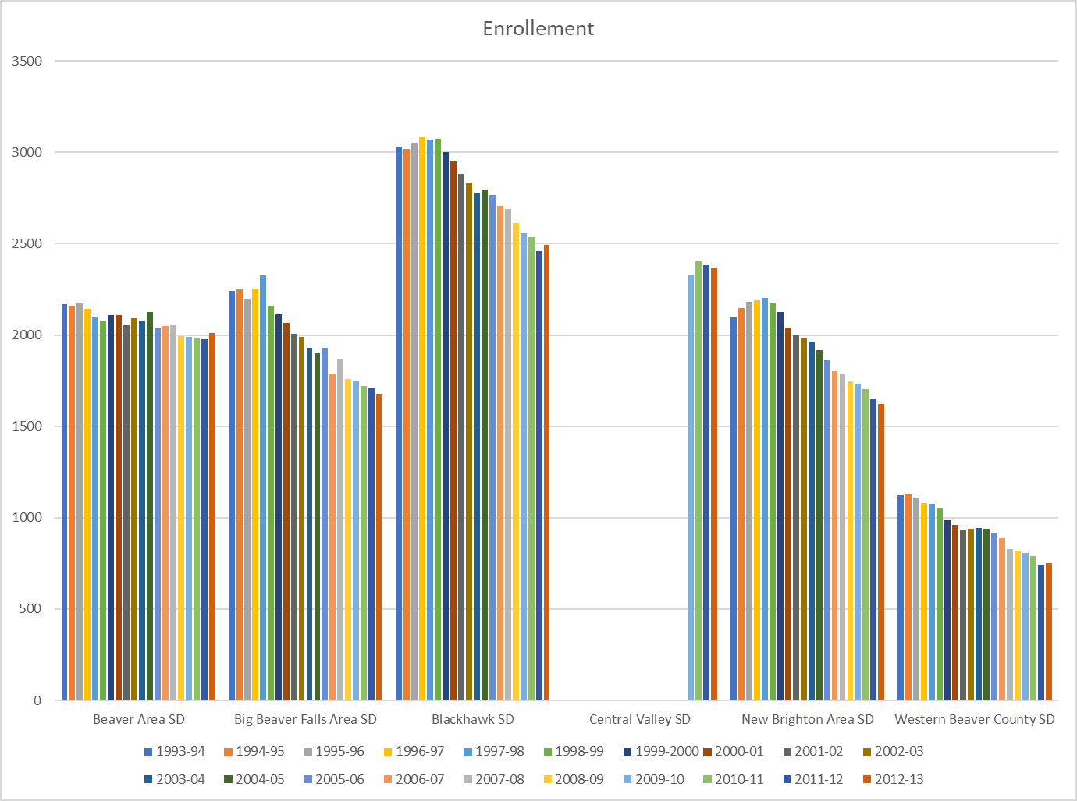
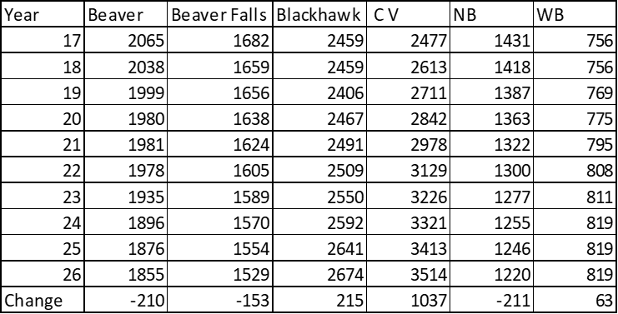
DATA SOURCES – Relevance / Correlation
(PA Department Education , BC Comprehensive Plan……)
(PA Department Education , BC Comprehensive Plan, Transfinder, Prior Studies……)
Notes:
Dan and Tom

Slide 4
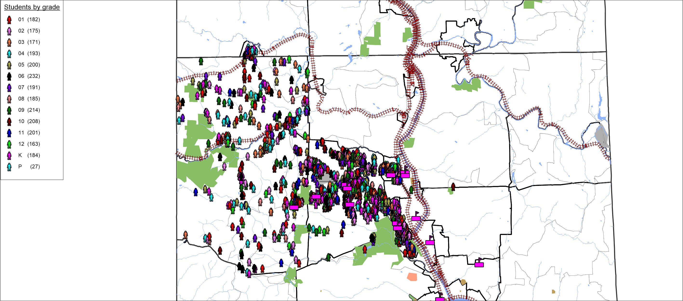
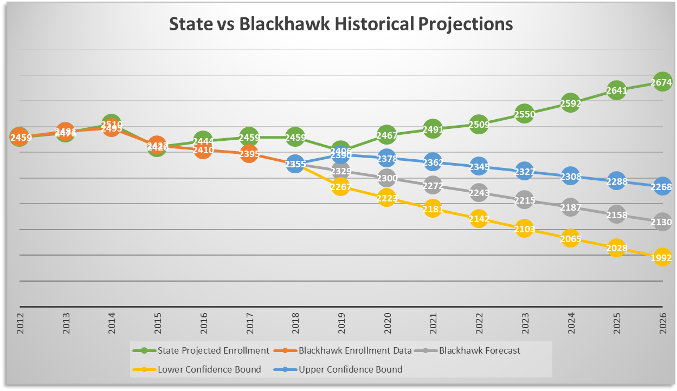
Student locations – All Grades Current Projections

Slide 5
Do we need a demographer?
Resources
Overwhelming data
Accuracy
State stopped data projections in 2012
Notes:
Mark

Slide 6
Davis vs. Stewman
Both shared proposals
Conference call with both companies
Notes:
Dave

Slide 7
Stewman
Notes:
Amy

Slide 8
Stewman

Slide 9
Stewman

Slide 10
Stewman
Works with more local districts
Cost controlled
Be on site working with municipalities
Aware of economic changes in our area
Accuracy Rate
Schools are repeated customers
Will provide several scenarios and what it could mean for population
Completion Date: May 2019 (even if we decide in January)
Cost: $15,000-$16,000
*Proposal available*

Slide 11
Davis
A la carte
Two visits
*Proposal available*

